Slide 1
Inheritance and Interfaces
Part I
Dr. Phesto Namayala , 2024

Slide 2
Learning Objectives
At the end of this lecture, students must
Understand the meaning of inheritance, types, and terms linked, including super classes, sub-classes, protected members, and constructors in sub-classes

Slide 3
Inheritance
Inheritance is the procedure or mechanism of acquiring all the properties and behaviors of one class to another, i.e., acquiring the properties and behavior of the child class from the parent class.
It represents the IS-A relationship, also known as the parent-child relationship.
It can be used for Method Overriding (so runtime polymorphism can be achieved) and for Code Reusability

Slide 4
Inheritance…
Inheritance in Java is divided into single, multilevel, and hierarchical inheritance. However, multiple and hybrid inheritance are supported only through the interface.
Syntax of creating inheritance in java
class subClass extends superClass
{
//methods and fields
}

Slide 5
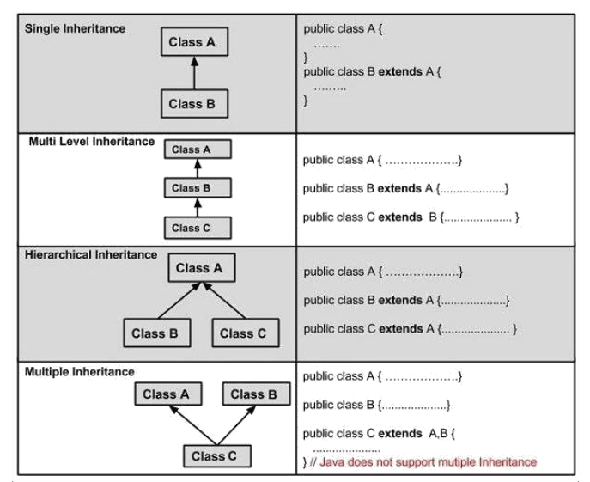

Inheritance…

Slide 6
Inheritance..
In single inheritance, one class extends another class (one class only).
Example
public class ClassA
{
public void dispA()
{
System.out.println("disp() method of ClassA");
}
}
public class ClassB extends ClassA
{
public void dispB()
{
System.out.println("disp() method of ClassB");
}
public static void main(String args[])
{
ClassB b = new ClassB();
b.dispA();
b.dispB();
}
}

Slide 7
Inheritance..
In multiple inheritance, one class can inherit from a derived class. Hence, the derived class becomes the base class for the new class.
Example,
public class ClassA
{
public void dispA()
{
System.out.println("disp() method of ClassA");
}
}
public class ClassB extends ClassA
{
public void dispB()
{
System.out.println("disp() method of ClassB");
}
}
public class ClassC extends ClassB
{
public void dispC()
{
System.out.println("disp() method of ClassC");
}
public static void main(String args[])
{
ClassC c = new ClassC();
c.dispA();
c.dispB();
c.dispC();
}
}

Slide 8
Inheritance..
In Hierarchical Inheritance, one class is inherited by many sub-classes.
Example,
The example has been discussed in the class

Slide 9
Inheritance..
Hybrid Inheritance is the combination of Single and Multiple Inheritance. Again, hybrid inheritance is not directly supported in Java; we can achieve this only through an interface.
Multiple Inheritance is nothing but one class extending more than one class. This type of inheritance is not supported by many object-oriented programming languages such as Java, Small Talk, and C#. However, it is supported by C++. In Java, multiple inheritance can be supported by interfaces

Slide 10
super KEYWORD
Usage of super keyword
1. super() invokes the constructor of the parent class.
2. super.variable_name refers to the variable in the parent class.
3. super.method_name refers to the method of the parent class.

Slide 11
1. super() invokes the constructor of the parent class
super() will invoke the constructor of the parent class.
Even when you don’t add a super() keyword, the compiler will add one and invoke the Parent Class constructor.
class ParentClass
{
ParentClass()
{
System.out.println("Parent Class default Constructor");
}
}
public class SubClass extends ParentClass
{
SubClass()
{
System.out.println("Child Class default Constructor");
}
public static void main(String args[])
{
SubClass s = new SubClass();
}
}

Slide 12
1. super() invokes the constructor of the parent class
class ParentClass
{
ParentClass()
{
System.out.println("Parent Class default Constructor");
}
}
public class SubClass extends ParentClass
{
SubClass()
{
super();
System.out.println("Child Class default Constructor");
}
public static void main(String args[])
{
SubClass s = new SubClass();
}
}

Slide 13
1. super() invokes the constructor of the parent class
You can also call the parameterized constructor of the Parent Class. For example, super(10) will call a parameterized constructor of the Parent class.
Consider below example.

Slide 14
1. super() invokes the constructor of the parent class
class ParentClass
{
ParentClass()
{
System.out.println("Parent Class default Constructor called");
}
ParentClass(int val)
{
System.out.println("Parent Class parameterized Constructor, value: "+val);
}
}
public class SubClass extends ParentClass
{
SubClass()
{
super();
}
SubClass(int val)
{
super(10);
System.out.println("Child Class parameterized Constructor, value: "+val);
}
public static void main(String args[])
{
SubClass s = new SubClass();
SubClass s1 = new SubClass(10);
}
}

Slide 15
2. super.variable_name refers to the variable in the parent class
When we have the same variable in both parent and subclass, we can not display the variable of the parent class without using the super keyword.
Consider two examples below.

Slide 16
2. super.variable_name refers to the variable in the parent class..
class ParentClass
{
int val=999;
}
public class SubClass extends ParentClass
{
int val=123;
void disp()
{
System.out.println("Value is : "+val);
}
public static void main(String args[])
{
SubClass s = new SubClass(); s.disp();
}
}

Slide 17
2. super.variable_name refers to the variable in the parent class ..
class ParentClass
{
int val=999;
}
public class SubClass extends ParentClass
{
int val=123;
void disp()
{
System.out.println("Value is : "+super.val);
}
public static void main(String args[])
{
SubClass s = new SubClass();
s.disp();
}
}

Slide 18
3. super.method_name refers to the method of the parent class
When you override the Parent Class method in the Child Class without super keywords support, you will not be able to use the Parent Class method.
Consider example below.

Slide 19
3. super.method_name refers to the method of the parent class ..
class ParentClass
{
void disp()
{
System.out.println("Parent Class method");
}
}
public class SubClass extends ParentClass
{
void disp()
{
System.out.println("Child Class method");
}
void show()
{
disp();
}
public static void main(String args[])
{
SubClass s = new SubClass();
s.show();
}
}

Slide 20
3. super.method_name refers to the method of the parent class ..
class ParentClass
{
void disp()
{
System.out.println("Parent Class method");
}
}
public class SubClass extends ParentClass
{
void disp()
{
System.out.println("Child Class method");
}
void show()
{
disp();
//Calling ParentClass disp() method
super.disp();
}
public static void main(String args[])
{
SubClass s = new SubClass(); s.show();
}
}

Slide 21
3. super.method_name refers to the method of the parent class ..
When there is no method overriding then by default Parent Class disp() method will be called.
class ParentClass
{
public void disp()
{
System.out.println("Parent Class method");
}
}
public class SubClass extends ParentClass
{
public void show()
{
disp();
}
public static void main(String args[])
{
SubClass s = new SubClass();
s.show(); }}

